Slide 1
Functions
Integrated Mathematics

Slide 2
Objectives
Students will be able to:
1. To determine if a relation is a
function.
2. To find the value of a function.

Slide 3
Functions
A function is a relation in which each element of the domain is paired with exactly one element of the range. Another way of saying it is that there is one and only one output (y) with each input (x).
x
y
f(x)

Slide 4
Function Notation
Input
Name of Function
Output

Slide 5
Determine whether each relation is a function.
Ex.1) {(2, 3), (3, 0), (5, 2), (4, 3)}

Slide 6
Determine whether the relation is a function.
Ex. 2) {(4, 1), (5, 2), (5, 3), (6, 6), (1, 9)}

Slide 7
Try These
Determine if the following are functions?
{(1,3), (2,3), (3,3)}
{(4,6), (8,9), (10,6)}
{(-4,3), (0,9), (23,-15)}
{(-1,7), (-4,13), (-4,23)}

Slide 8
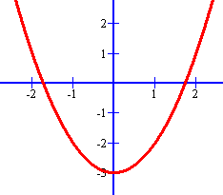
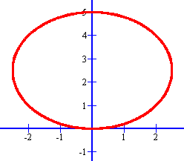
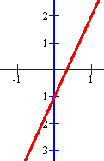
Vertical Line Test (Pencil Test)
If any vertical line passes through more than one point of the graph, then that relation is not a function.
Are these functions?

Slide 9
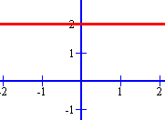
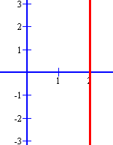
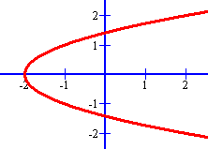
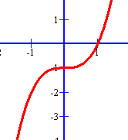
Vertical Line Test

Slide 10
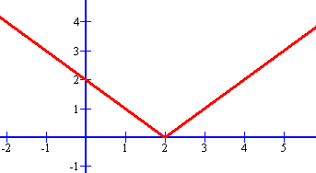
Is this a graph of a function?

Slide 11
Given f(x) = 3x - 2, find:
1) f(3)
2) f(-2)

Slide 12
Given h (z) = z² - 4z + 9, find h (-3)

Slide 13
Try These
Given g(x) = x² – 2, find g(4)
Given f(x) = 2x + 1, find f(3) – f(1)

